Slide 1
Layered Architecture
.
Computer networks are operated by network models; most prominently the Open System Interconnect Reference Model (OSIRM) and the TCP/ IP Model.
Concept of Layered Task
The main objective of a computer network is to be able to transfer the data from sender to receiver. This can be done by breaking it into small sub tasks, each of which are well defined.
Each subtask will have its own process or processes to do and will take specific inputs and give specific outputs to the subtask before or after it.
(In more technical terms we can call these sub tasks as layers)
In general, every task or job can be done by dividing it into sub task or layers.
2.<number>

Slide 2
Principles of Protocol Layering
.
Two principles of protocol layering.
The first principle dictates that if bidirectional communication, is required, then each layer is made responsible to perform two opposite tasks, one in each direction.
The second principle that to be followed in protocol layering is that the two objects under each layer at both sites should be identical.
2.<number>

Slide 3
Layered Architecture
.
Open System Interconnection Reference Model (OSIRM)
The OSIRM or OSI Model was developed by International Organization for Standardization (ISO).
ISO is the organization, OSI is the model.
It was developed to allow systems with different platforms to communicate with each other. Platform could mean hardware, software or operating system.
It is a network model that defines the protocols for network communications.
It is a hierarchical model that groups its processes into layers. It has 7 layers.
Each layer has specific duties to perform and has to cooperate with the layers above and below it.
2.<number>

Slide 4
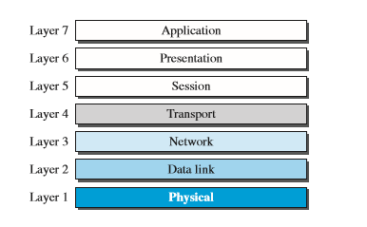
The OSI model
2.<number>

Slide 5
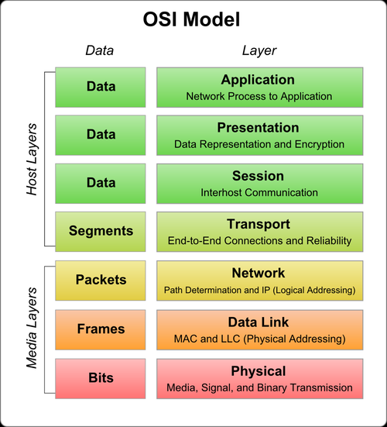
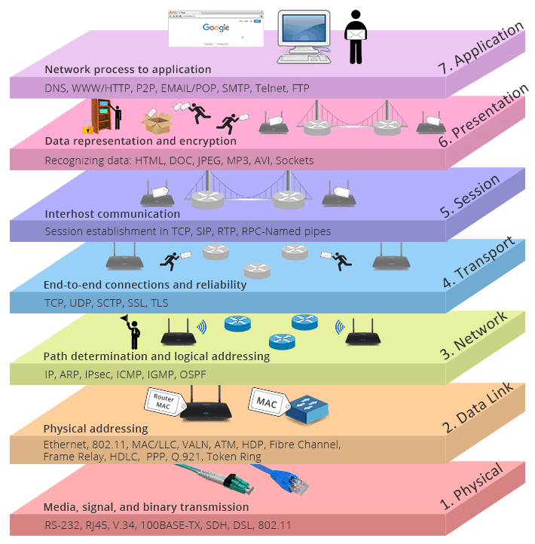
Layered Architecture – OSI Layer
2.<number>

Slide 6
Layered Architecture – OSI Layer
The responsibilities of the 7 layers of OSI model can be summarized as follows:
1. Application Layer To provide the users access to network resources
2. Presentation Layer To provide the functions of translation, encryption and compression.
3. Session Layer To establish, manage and terminate sessions
4. Transport Layer To provide process to process delivery of message
5. Network Layer To provide source to destination delivery of packets.
6. Datalink Layer To provide hop to hop delivery of frames
7. Physical Layer To transmit data over a bit stream from one hop to the next and provide electrical and mechanical specification.
2.<number>

Slide 7
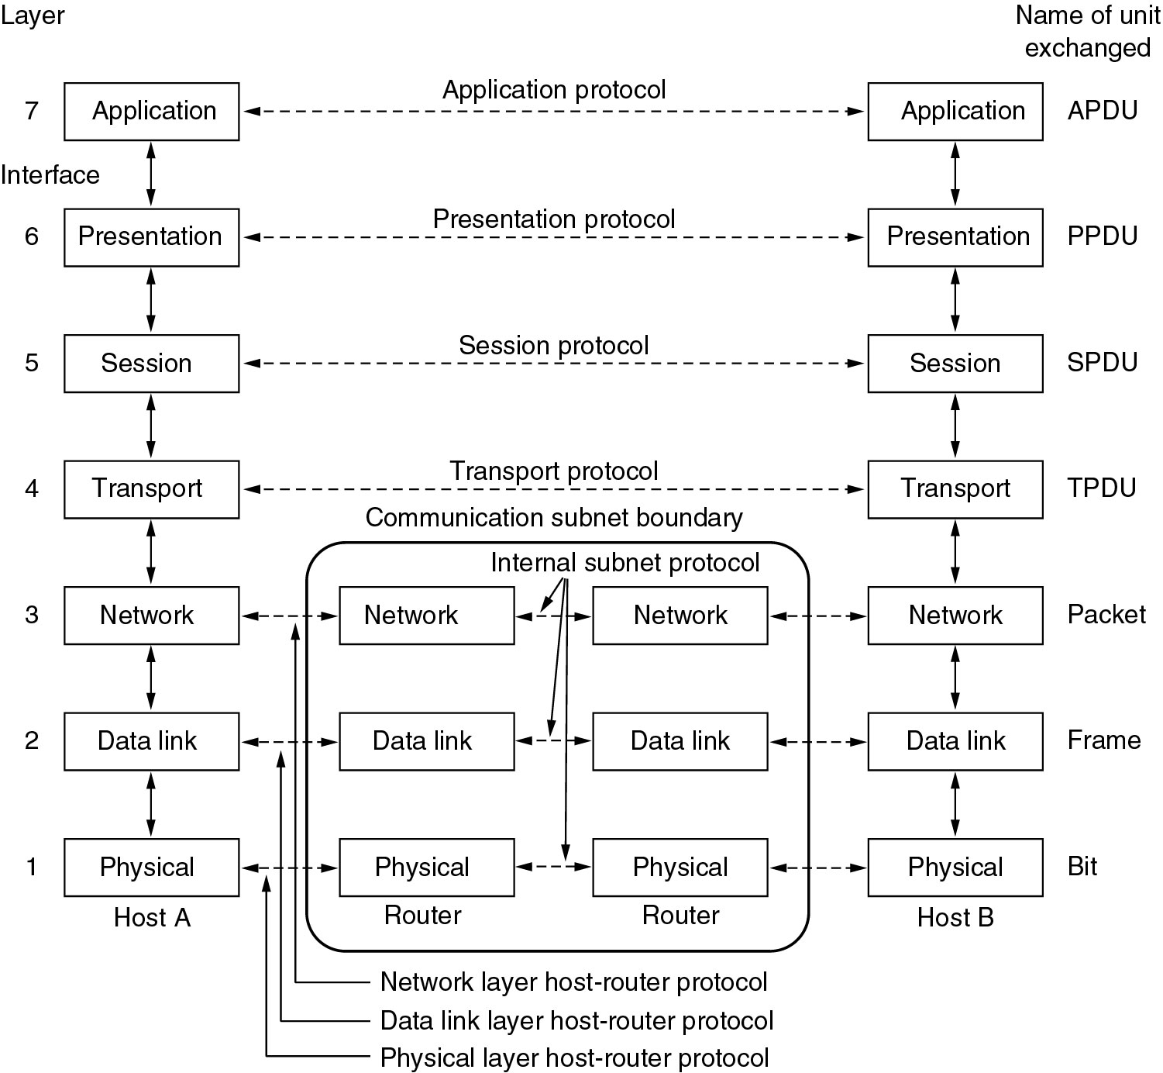
The OSI model
2.<number>

Slide 8
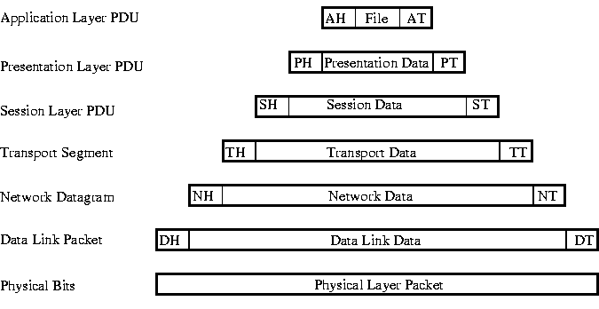
The OSI model
Each layer may add a Header and a Trailer to its Data (which consists of the next higher layer's Header, Trailer and Data as it moves through the layers). The Headers contain information that specifically addresses layer-to-layer communication. For example, the Transport Header (TH) contains information that only the Transport layer sees. All other layers below the Transport layer pass the Transport Header as part of their Data.
2.<number>

Slide 9
The Physical Layer
  Establishes the physical characteristics of the network (e.g., the type of cable, connectors, length of cable, etc.)
  Defines the electrical characteristics of the signals used to transmit the data (e.g. signal voltage swing, duration of voltages, etc.)
  Transmits the binary data (bits) as electrical or optical signals depending on the medium.
The Data Link Layer
  Defines how the signal will be placed on or taken off the NIC. The data frames are broken down into individual bits that can be translated into electric signals and sent over the network. On the receiving side, the bits are reassembled into frames for processing by upper levels.
  Error detection and correction is also performed at the data link layer. If an acknowledgement is expected and not received, the frame will be resent. Corrupt data is also identified at the data link layer.
  Because the Data-Link Layer is very complex, it is sometimes divided into sublayers (as defined by the IEEE 802 model). The lower sublayer controls medium access. The upper sublayer is concerned with sending and receiving packets and error checking.
2.<number>

Slide 10
The Network Layer
  Primarily concerned with addressing and routing. Logical addresses (e.g., an IP address) are translated into physical addresses (i.e., the MAC address) for transmission at the network layer. On the receiving side, the translation process is reversed.
  It is at the network layer where the route from the source to destination computer is determined. Routes are determined based on packet addresses and network conditions. Traffic control measures are also implemented at the network layer.
The Transport Layer
  On the sending side, messages are packaged for efficient transmission and assigned a sequence number so they can be reassembled in proper order. On the receiving side, the packets are reassembled, checked for errors and acknowledged.
  Performs error handling in that it ensures all data is received in the proper sequence and without errors. If there are errors, the data is retransmitted.
2.<number>

Slide 11
The Session Layer
  Is responsible for establishing, maintaining, and terminating a connection called a 'session'.
  A session is an exchange of messages between computers (a dialog). Managing the session involves synchronization of user tasks and dialog control (e.g., who transmits and for how long). Synchronization involves the use of checkpoints in the data stream. In the event of a failure, only the data from the last checkpoint has to be resent.
  Logon, name recognition and security functions take place at the Session Layer.
The Presentation Layer
  It is responsible for data translation (formatting), compression, and encryption.
  The Presentation Layer is primarily concerned with translation; interpreting and converting the data from various formats. For example, EBCDIC characters might be converted into ASCII. It is also where data is compressed for transmission and uncompressed on receipt. Encryption techniques are implemented at the Presentation Layer.
  The redirector operates at the presentation layer by redirecting I/O operations across the network.
The Application Layer
  Provides the operating system with direct access to network services.
  It serves as the interface between the user and the network by providing services that directly support user applications.
2.<number>

Slide 12
Layering- a Summary
Layer | Responsibility | Other functions | Protocol | Address used and size
Application | Runs applications e.g. email, web browser, messaging |  | Email ; FTP ; HTTP; SMTP; TELENET | ---
Presentation | Source coding Encryption & Decryption Compression techniques |  | --- | ---
Session | Dialog controller Synchronization |  | SIP | ---
Transport | Provides for logical communication between applications | Flow control Error control Congestion control | TCP UDP | Port address and 2 bytes
Network | Delivers packets from source to destination over a network | Logical Addressing Encapsulation Routing Forwarding | IP ; ARP; RARP IGMP | Logical address and 4 bytes
Data Link | Handles data transfer from between adjacent nodes | Framing, Flow control Error control | HDLC | Physical address 6 bytes
Physical | Physical layer deals with properties of medium | Wired/Wireless, Data rate, Channel access methods, Line coding. | --- | Bits “on the wire”
2.<number>

Slide 13
TCP/IP PROTOCOL SUITE
The layers in the TCP/IP protocol suite do not exactly match those in the OSI model. The original TCP/IP protocol suite was defined as having four layers: host-to-network, internet, transport, and application. However, when TCP/IP is compared to OSI, we can say that the TCP/IP protocol suite is made of five layers: physical, data link, network, transport, and application.
Topics discussed in this section:
Physical and Data Link Layers
Network Layer
Transport Layer
Application Layer
2.<number>

Slide 14
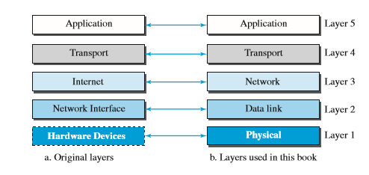
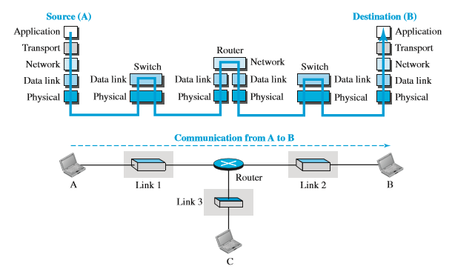
TCP/IP PROTOCOL SUITE
2.<number>

Slide 15
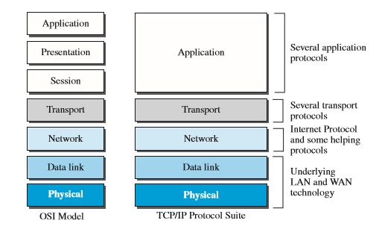
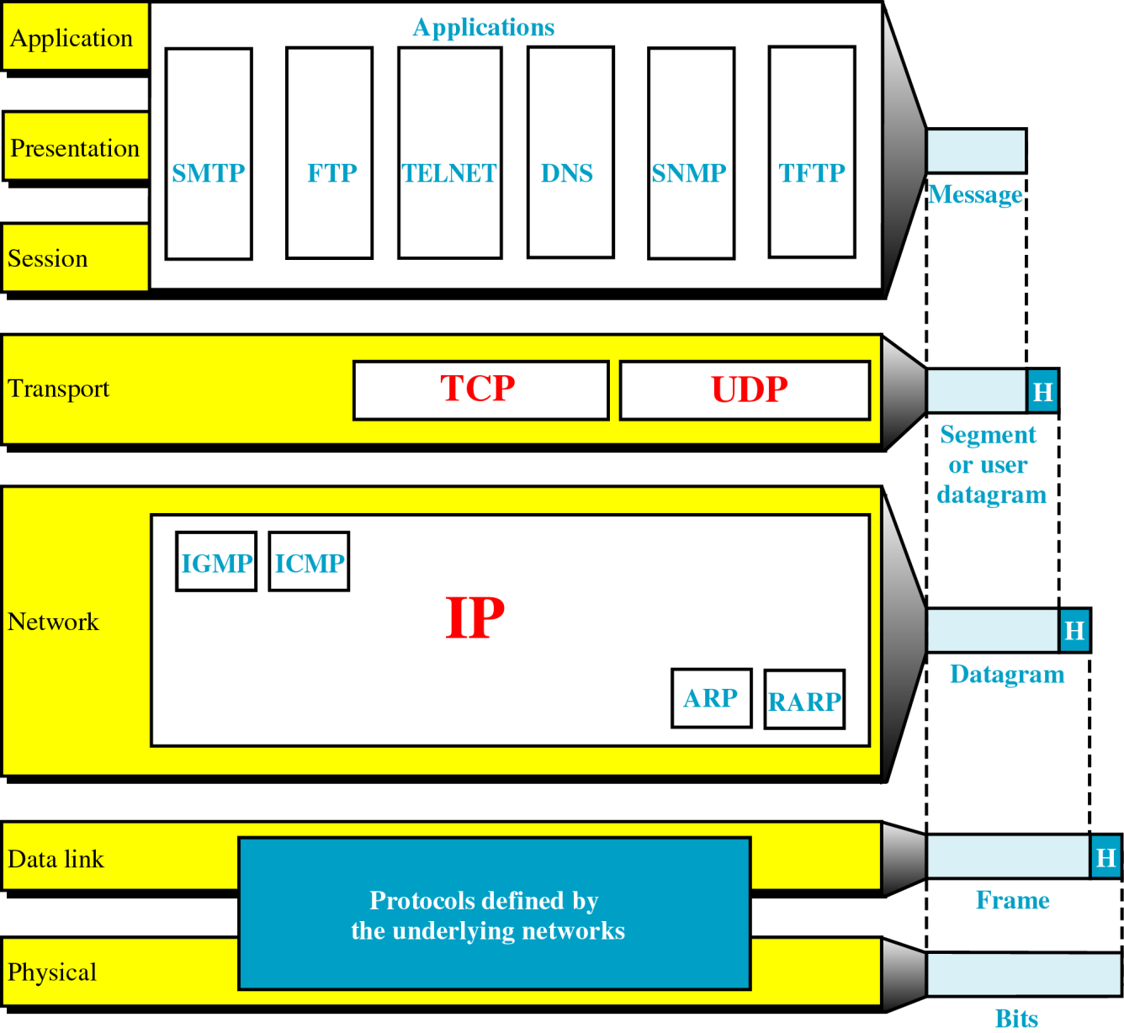
OSI versus TCP/IP
2.<number>

Slide 16
PHYSICAL AND DATA LINK LAYERS
Does not define any specific protocol.
Supports all the standard and proprietary protocols.
2.<number>

Slide 17
NETWORK LAYER
Uses Internetworking Protocol (IP)
IP uses 4 supporting protocols
Address Resolution Protocol (ARP)
Reverse Address Resolution Protocol (RARP)
Internet Control Message Protocol (ICMP)
Internet Group Message Protocol (IGMP)
2.<number>

Slide 18
IP
Transmission mechanism used by TCP/IP
Unreliable and connectionless protocol
IP transports data in packets called Datagrams
Transported separately, along different routes and arrive out of sequence.
Does not keep track of the routes and has no facility for reordering datagrams.
2.<number>

Slide 19
ARP
Used to associate logical address with a physical address.
Each device on a link is identified by a physical or station address, imprinted on NIC.
ARP- finds physical address of the node when its Internet address is known.
2.<number>

Slide 20
RARP
Discovers node’s Internet address when it knows only its physical address
ICMP
Mechanism used by hosts and gateways to send notification of datagram problems back to the sender.
ICMP sends query and error reporting messages.
2.<number>

Slide 21
IGMP
Used to facilitate the simultaneous transmission of a message to a group of recipients.
TRANSPORT LAYER
IP is a host to host protocol – deliver a packet from one physical device to another.
Transport level protocols responsible for delivery of a message from a process to another process.
Transmission Control Protocol (TCP)
User Datagram Protocol (UDP)
Stream Control Transmission Protocol (SCTP)
2.<number>

Slide 22
UDP
UDP is a process to process protocol that adds only port addresses, checksum error control, and length information to the data from the upper layer.
SCTP
Provides support for newer applications such as VOIP.
Combines the best features of UDP and TCP.
2.<number>

Slide 23
TCP
Provided full transport layer services to applications
Reliable stream transport protocol- Connection oriented.
A connection must be established between both ends of a transmission before either can transmit data
At the sender side, TCP divides a stream of data into smaller units called segments which includes a sequence number.
Segments are carried across the internet inside of
IP datagrams.
At the receiver side, TCP collects each datagram as it comes in and reorders the transmission based on sequence numbers.
2.<number>

Slide 24
APPLICATION LAYER
Application layer in TCP/IP is equivalent to the combined session, presentation and application layers in the OSI model.
2.<number>

